Slide 1

Fundamentals of Python Programming
Mojtaba Ghasemi

Slide 2





About me
Mojtaba Ghasemi
Senior Data Scientist
Ph.D. in Biomedical Engineering fromUniversity de Montreal
https://github.com/MJTGhasemi
https://ca.linkedin.com/in/mojtabaghasemi/
420-TT3-UM - Data Visualization and Reporting Tool | Montreal College IT

Slide 3
About you
- Background
- Enrolled program
- Highest education level
- Programming experience
420-SS9-UM - Fundamentals of Python Programming | Montreal College IT

Slide 4
Course Outline
- Introduction to Python Programming
- Python Environment Setup
- Python Object Types
- Python Code Structure and Syntax
- Functions and Generators
- Object-Oriented Programming in Python
- Modular Programming in Python
- Introduction to NumPy, Pandas
420-SS9-UM - Fundamentals of Python Programming | Montreal College IT

Slide 5
Course Evaluations
- Assignments
25%
- Projects
25%
- Final Exam and Final Project
50%
420-SS9-UM - Fundamentals of Python Programming | Montreal College IT

Slide 6
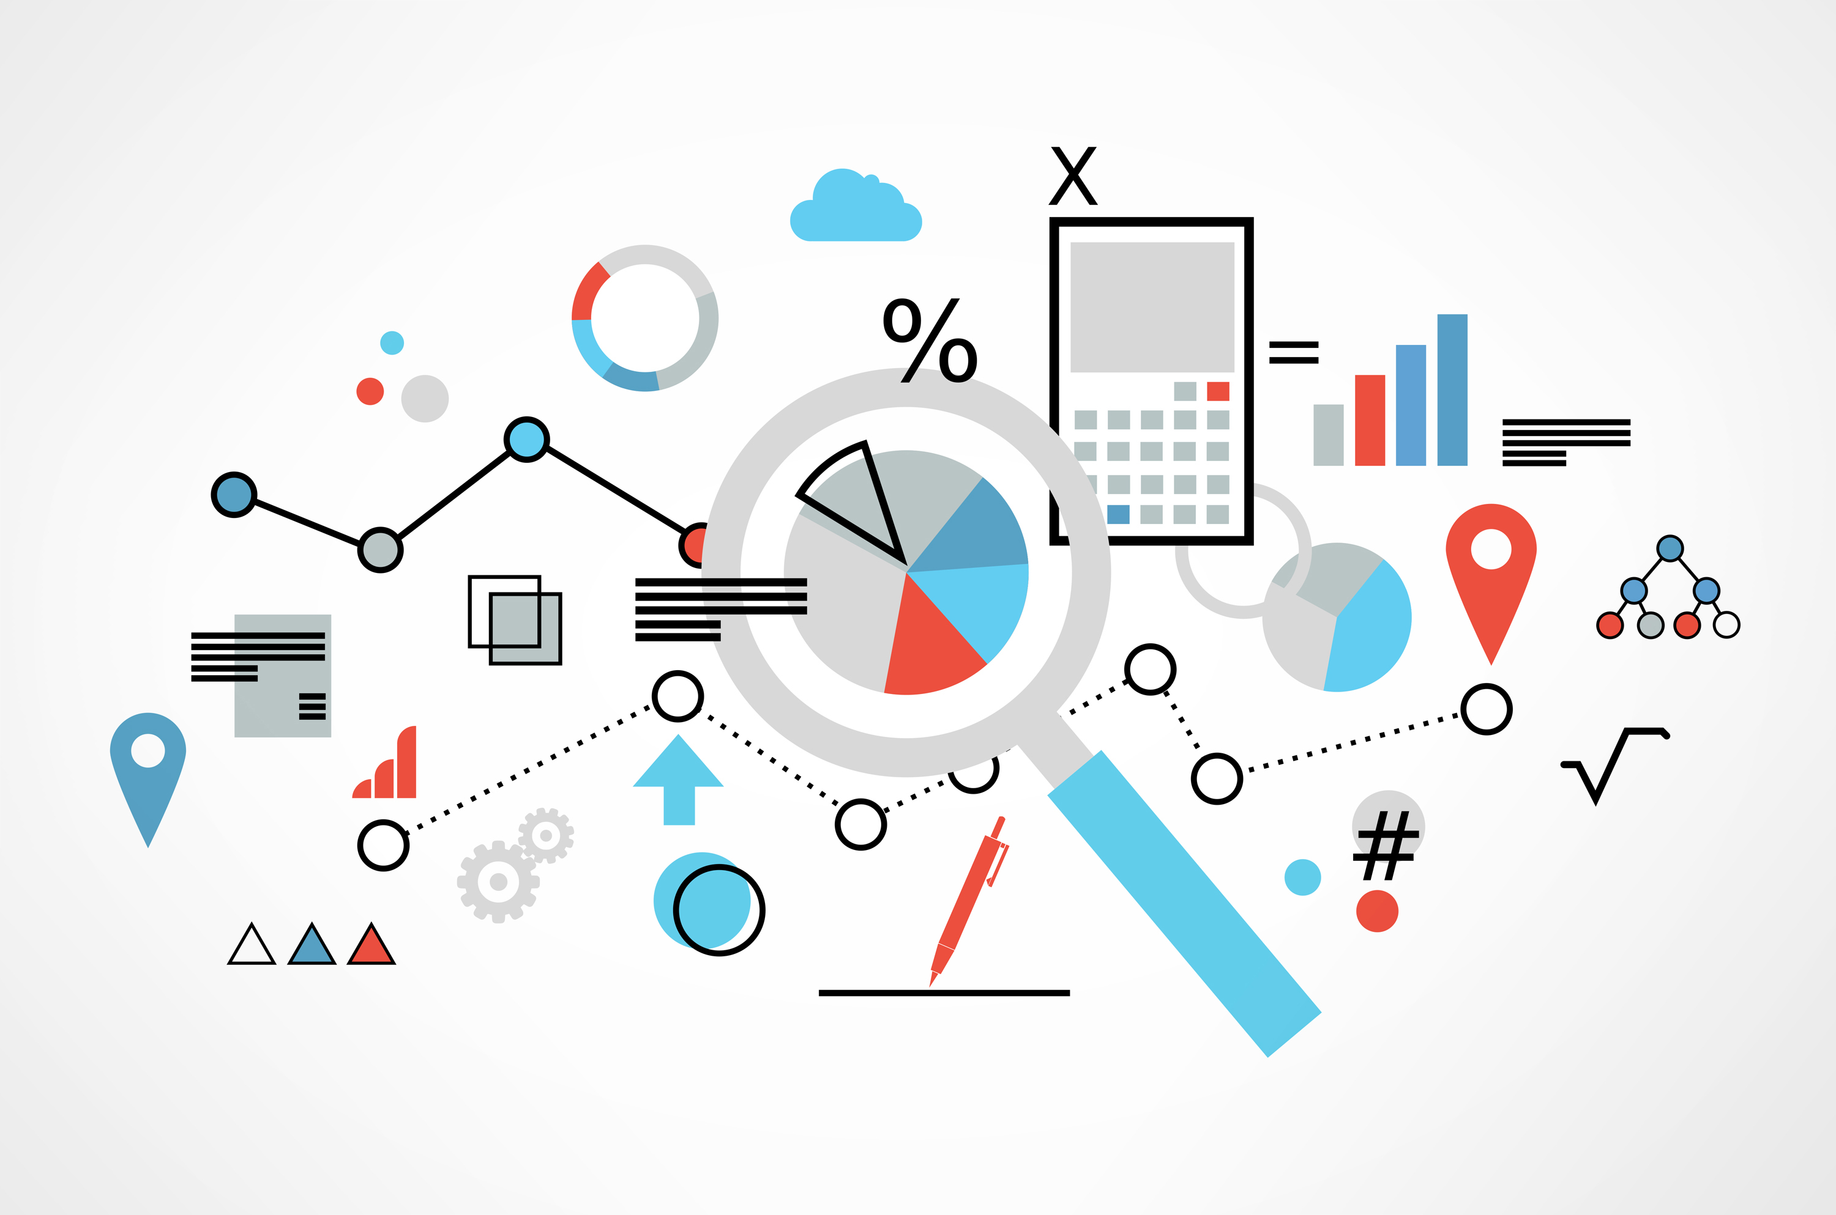
Data
Data refers to information gathered from different sources (sensor measurements, events, text, images, videos, etc.) through observations, measurements, research or analysis in order to provide:
Informed decision-making
Problem solving
Trend analysis
Performance measurement
Innovation
Personalization (tailor service to individual preferences)
Optimization
Risk management
Etc.
420-SS9-UM - Fundamentals of Python Programming | Montreal College IT

Slide 7
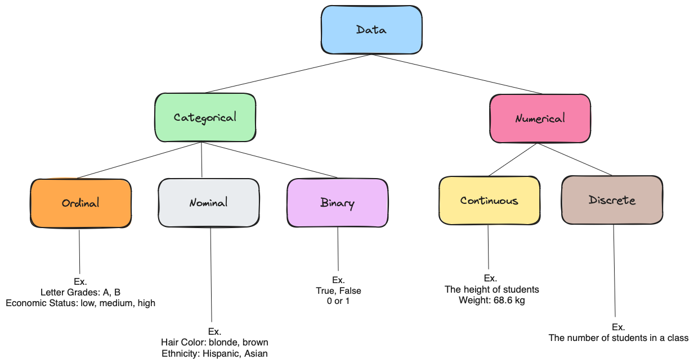
Data Types
Categorical: Data that can take on only a specific set of values representing a set of possible categories. (Synonyms: enums, enumerated, factors, nominal)
Binary: A special case of categorical data with just two categories of values, e.g., 0/1, true/false. (Synonyms: dichotomous, logical, indicator, boolean)
Ordinal: Categorical data that has an explicit ordering. (Synonym: ordered factor)
Nominal: represents discrete units and is used to label variables without providing any quantitative value or rank among categories
Numeric: Data that are expressed on a numeric scale.
Continuous: Data that can take on any value in an interval. (Synonyms: interval, float)
Discrete: Data that can take on only integer values, such as counts. (Synonyms: integer, count)
420-SS9-UM - Fundamentals of Python Programming | Montreal College IT

Slide 8
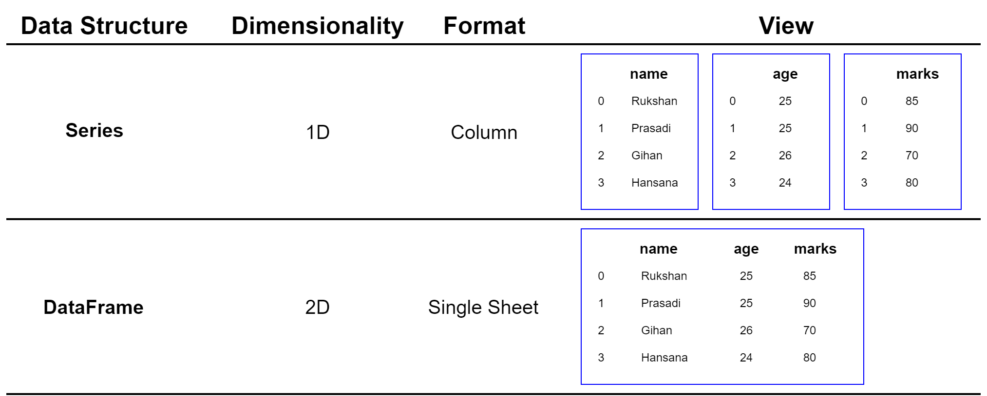
Data Structure
Series:
A Series is a one-dimensional labeled array capable of holding any data type. It is like a column in a table, ideal for representing one-dimensional data structures like a list of values.
DataFrame:
A two-dimensional labeled data structure with columns of potentially different types You can think of it like a spreadsheet or SQL table.
420-SS9-UM - Fundamentals of Python Programming | Montreal College IT

Slide 9
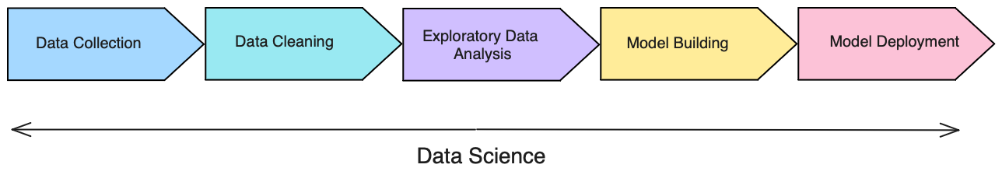
Understanding Data Cycle
- Data Collection: Aggregate and store data
- Data Cleaning: Data is usable and easily accessible
- Exploratory Data Analysis (EDA): Look for trends and high-level insights
- Model Building: Predict outcomes form the analysis
- Model Deployment: Make the model scalable for the business
420-SS9-UM - Fundamentals of Python Programming | Montreal College IT

Slide 10
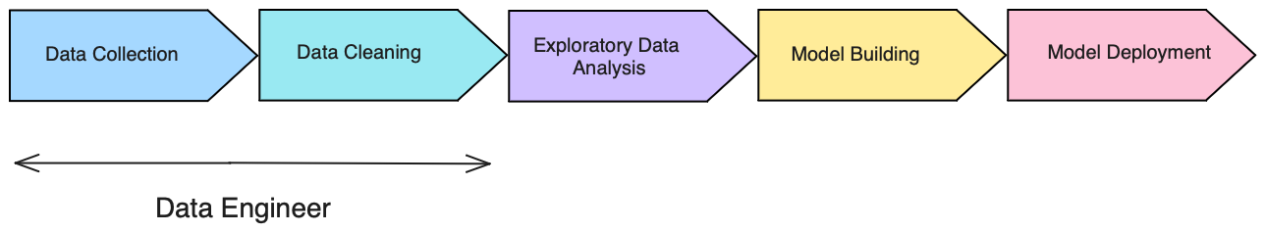
Understanding Data Cycle
Data Engineer:
Focuses on data collection and data cleaning
Strong SQL skills (pulling data and transforming it)
Extract, Transform, Load jobs (ETL)
Database maintenance techniques skills
420-SS9-UM - Fundamentals of Python Programming | Montreal College IT

Slide 11
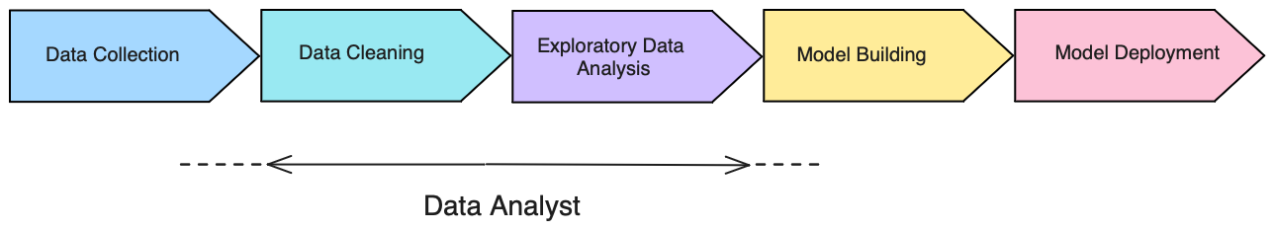
Understanding Data Cycle
Data / BI Analyst:
Focuses on data cleaning and EDA
Strong business intelligence skills (Excel, Power BI, Tableau)
Python, R skills
Do some data collection and model-building tasks
420-SS9-UM - Fundamentals of Python Programming | Montreal College IT

Slide 12
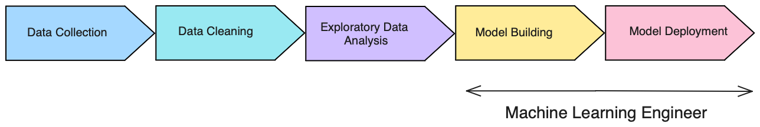
Understanding Data Cycle
Machine Learning Engineer (MLE):
Focuses on model building and putting models into production
Strong Python and other language (java, scala) skills
Strong understanding of ML tools and production environment
Software engineering skills
420-SS9-UM - Fundamentals of Python Programming | Montreal College IT

Slide 13
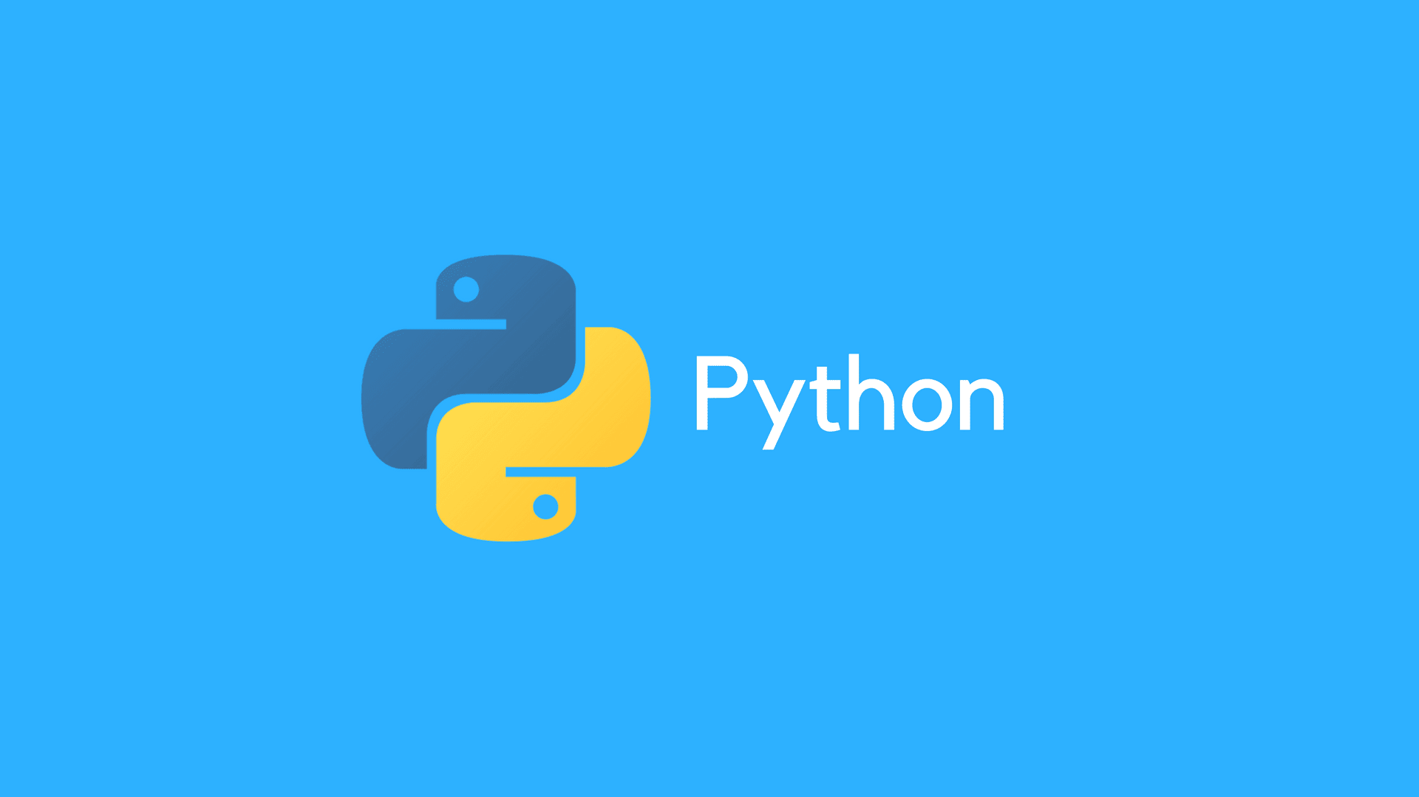
Introduction to
Programming

Slide 14
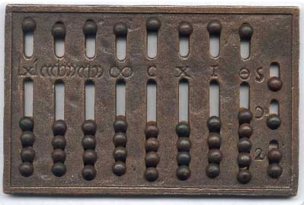
Early Programming
Computing technology has a history of transforming society, similar to the Industrial Revolution's impact on agriculture, industry, and domestic life.
The earliest recognized computing device was the abacus, which was invented around 2500 BCE to handle large-scale calculations.
420-SS9-UM - Fundamentals of Python Programming | Montreal College IT

Slide 15

Early Programming
Humans developed various computing devices over thousands of years, including astrolabes, slide rules, and calculators, which enhanced computation and reduced laborious calculations.
Charles Babbage proposed the Difference Engine and later the Analytical Engine, which laid the foundation for general-purpose computers and programmability.
420-SS9-UM - Fundamentals of Python Programming | Montreal College IT

Slide 16
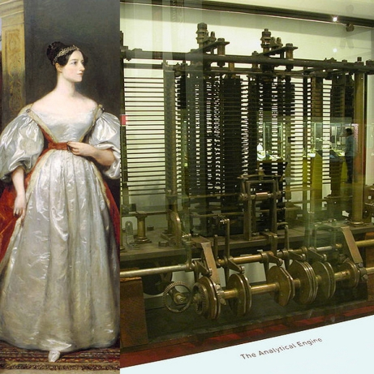
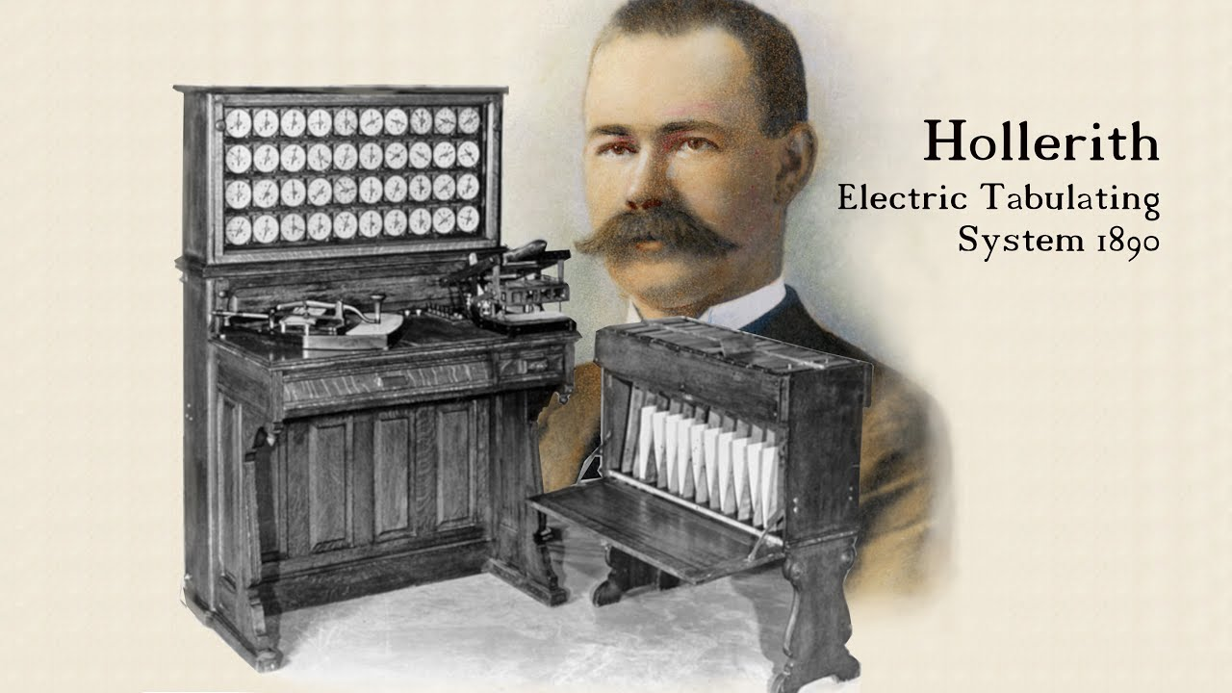
Early Programming
Ada Lovelace is often considered the world's first programmer for her hypothetical programs for the Analytical Engine.
Herman Hollerith's tabulating machine, which used punch cards and electro-mechanical systems, revolutionized data processing, saving time and money in tasks like the census.
420-SS9-UM - Fundamentals of Python Programming | Montreal College IT

Slide 17
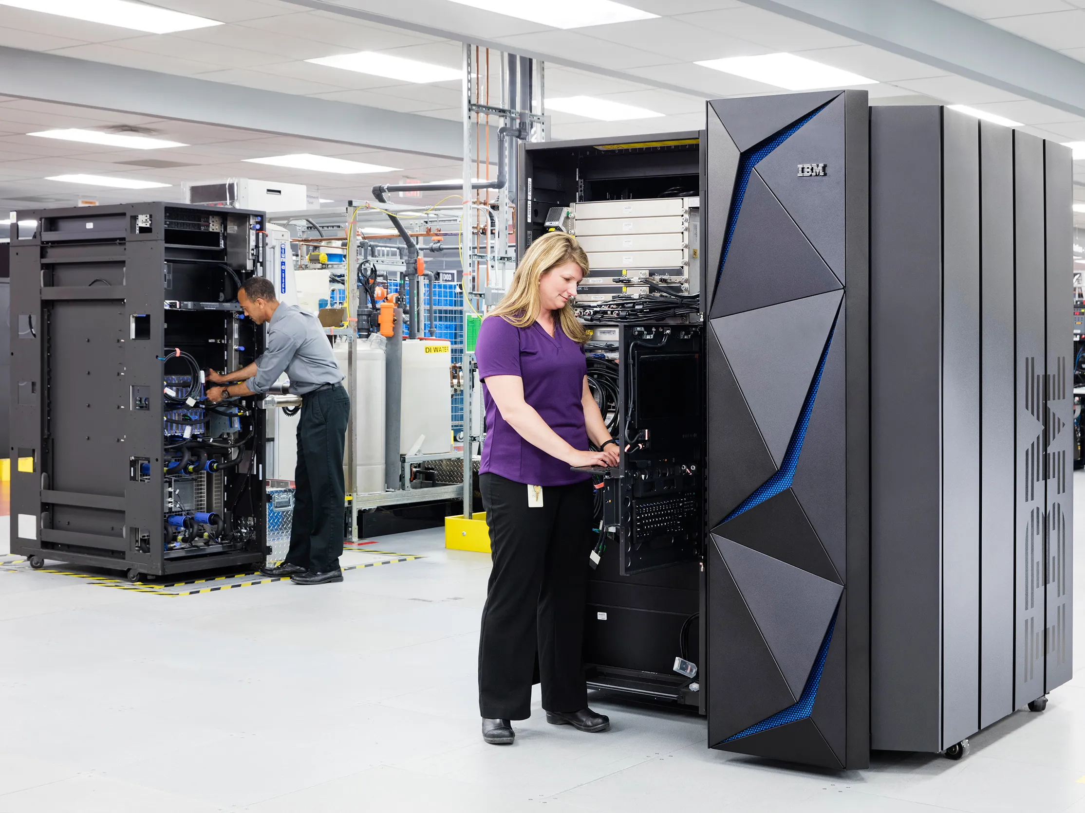
Early Programming
The success of tabulating machines led to the founding of The Tabulating Machine Company, later known as IBM, and sparked the recognition of computing's value in business and government.
The demand for faster and more flexible data processing tools set the stage for developing digital computers.
420-SS9-UM - Fundamentals of Python Programming | Montreal College IT

Slide 18
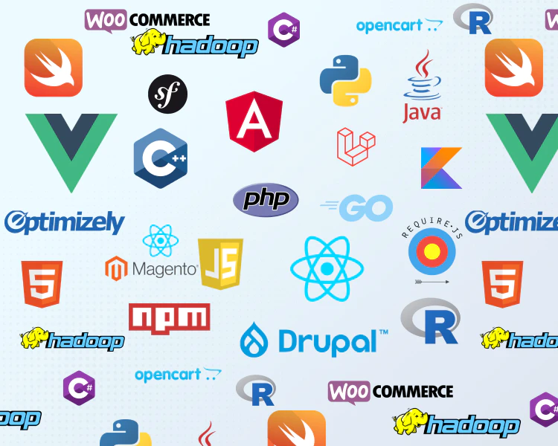
Early Programming
Programming languages are the tools that humans use to convey instructions to computers.
They serve as the foundation for writing software and creating applications that can perform a wide range of tasks.
Each programming language has:
unique syntax
rules
capabilities
suitable for specific purposes.
420-SS9-UM - Fundamentals of Python Programming | Montreal College IT

Slide 19
Early Programming
Early computers relied on plug boards and physical wiring, making programming complex and time-consuming.
Punch cards were used to input and output data in early computers.
The development of electronic memory in the late 1940s and 1950s led to stored-program computers and the von Neumann architecture.
Punch cards were commonly used to load programming data into computers until electronic memory became feasible.
420-SS9-UM - Fundamentals of Python Programming | Montreal College IT

Slide 20
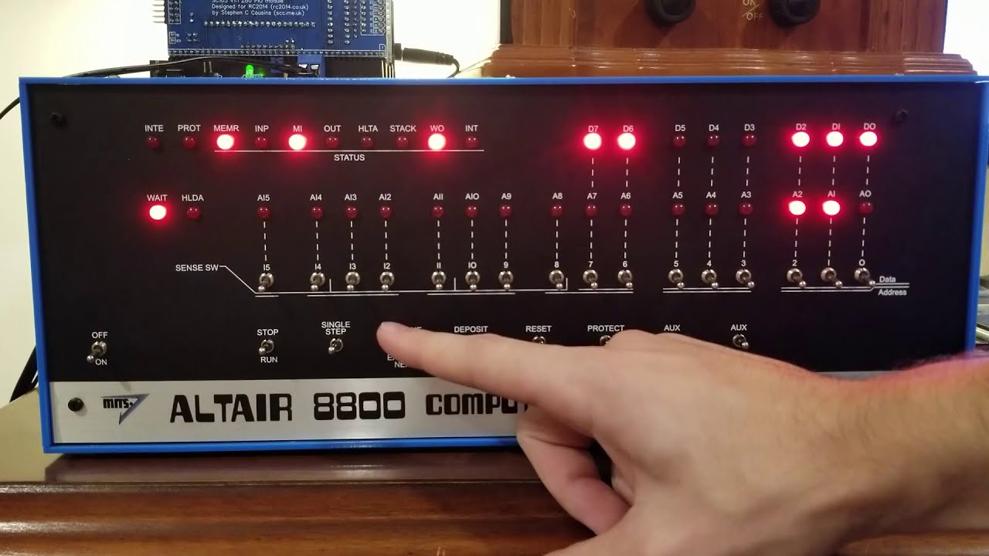
Early Programming
Panel programming, which involved switches and control panels, was another method used for programming early computers.
Early home computers, like the Altair 8800, relied on switches for programming.
Programming languages emerged as a simpler way to write programs, marking a significant advancement in computer programming.
420-SS9-UM - Fundamentals of Python Programming | Montreal College IT

Slide 21

Early Programming
The passage emphasizes the complexity and expertise required for early computer programming.
Punch cards and punched paper tape were important data storage methods in the early days of computing.
The passage hints at more advanced data storage technologies like hard drives, CDs, DVDs, and USB thumb drives.
420-SS9-UM - Fundamentals of Python Programming | Montreal College IT

Slide 22
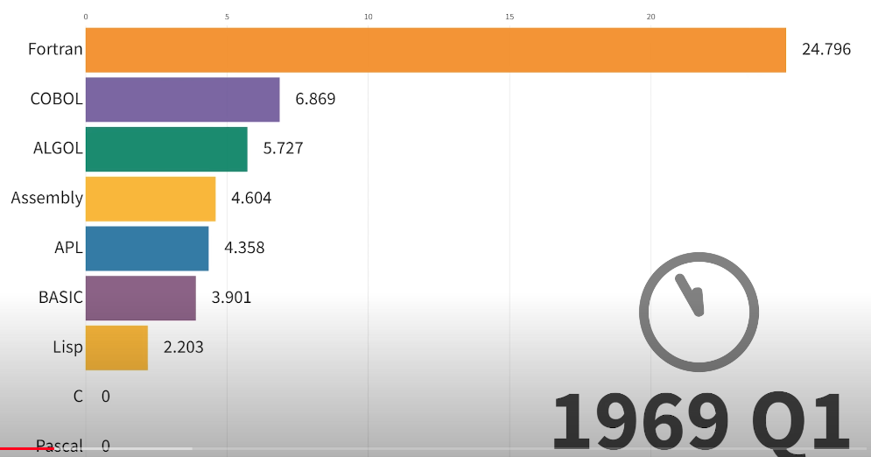
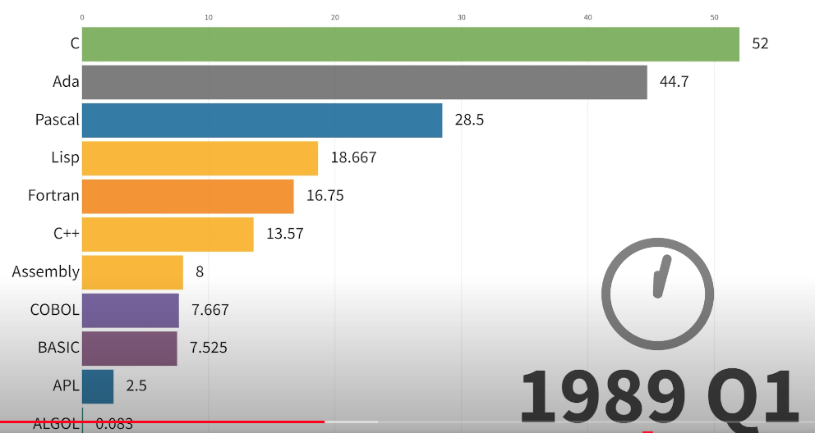
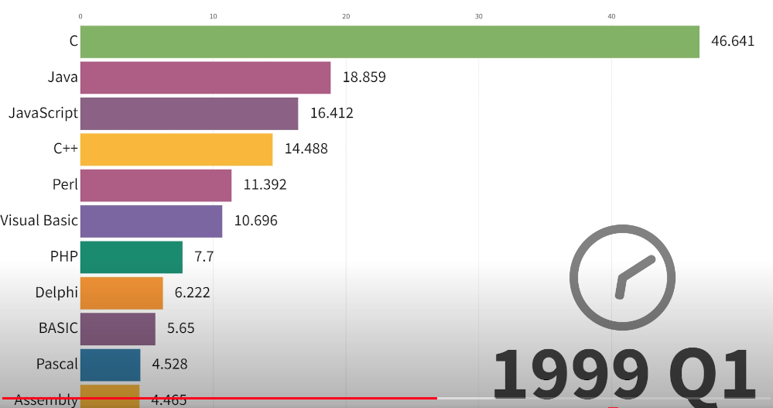
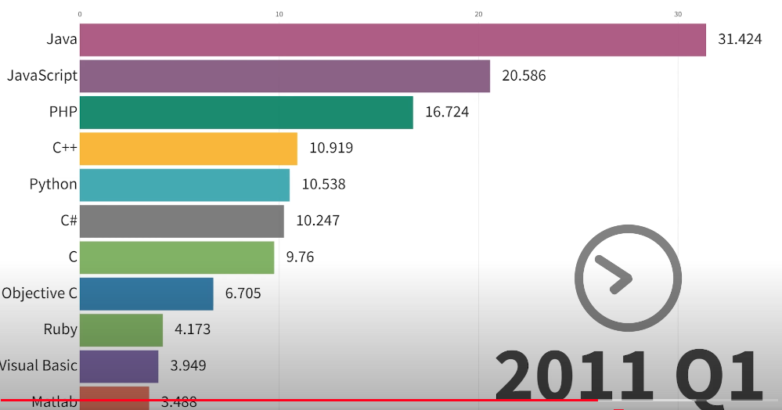
Introduction to Programming
420-SS9-UM - Fundamentals of Python Programming | Montreal College IT

Slide 23
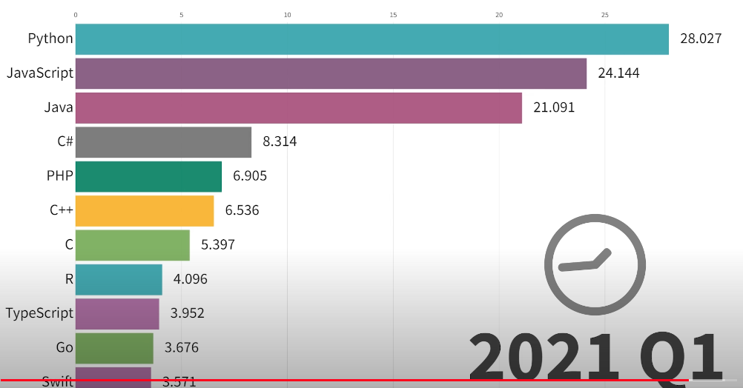
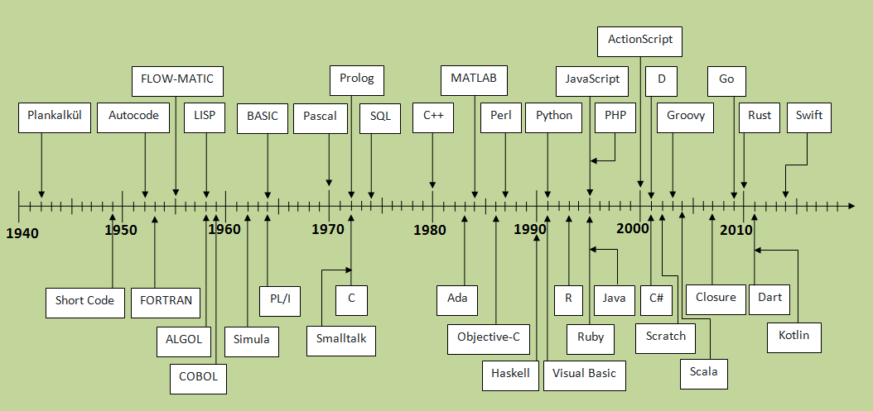
Introduction to Programming
420-SS9-UM - Fundamentals of Python Programming | Montreal College IT

Slide 24
Type of Programming languages
Programming languages can be categorized into various types, including:
High-Level Languages:
High-level programming languages are closer to human languages and further from machine code. They are designed to be easy to read and understand, making it easier for programmers to write, maintain, and debug code. These languages abstract away the complexities of the hardware, like memory management. Example: Python, Java, C#
Low-Level Languages:
Low-level languages are closer to machine code and provide less abstraction from the hardware. They offer more control over hardware and system resources, making them suitable for system programming. Example: Assembly Language, C
420-SS9-UM - Fundamentals of Python Programming | Montreal College IT

Slide 25
Type of Programming languages
Programming languages can be categorized into various types, including:
Scripting Languages:
Scripting languages are used for automating tasks and are often interpreted rather than compiled. They are usually easy to learn and write and can manipulate the objects of the system they are running on.
Example: JavaScript, Python, Bash
Domain-Specific Languages (DSL):
DSLs are specialized languages developed for specific tasks or domains. They are not general-purpose languages but tailored to solve problems efficiently in a specific area.
Example: SQL, HTML
420-SS9-UM - Fundamentals of Python Programming | Montreal College IT

Slide 26
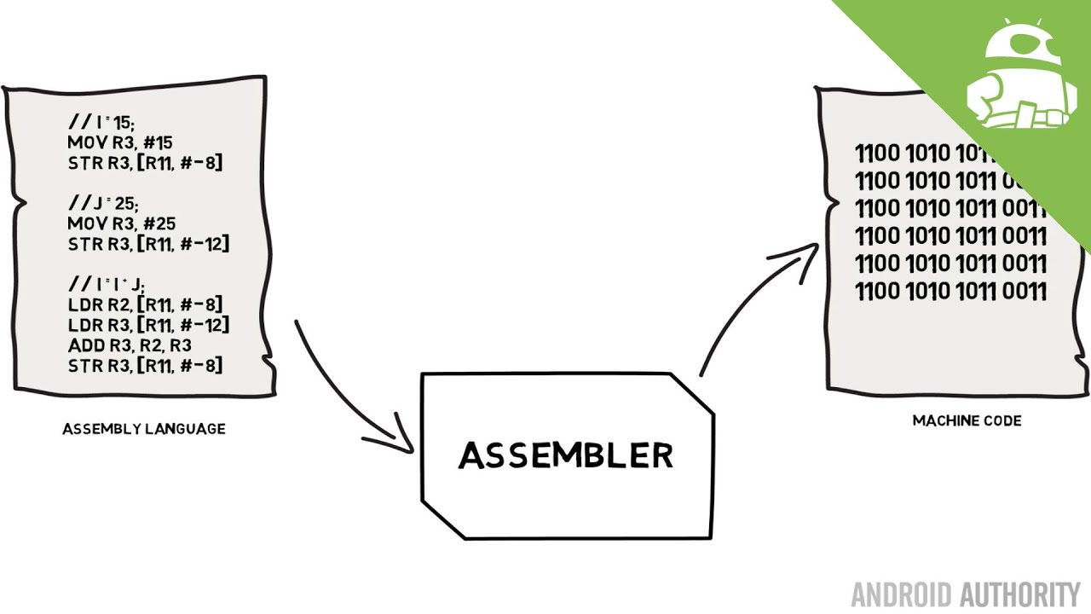
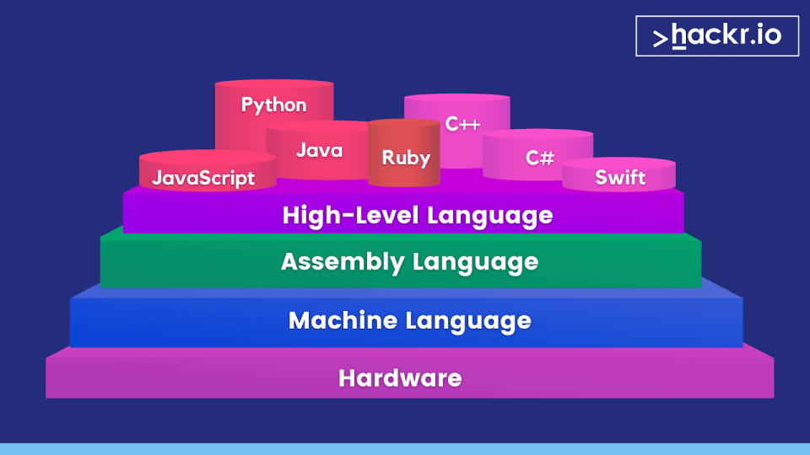
Type of Programming languages
High-level languages, such as Python, Java, and C++, are designed to be more human-readable and provide abstractions that simplify the process of coding.
Low-level languages, like assembly or machine code, offer more direct control over computer hardware but are less accessible to human programmers.
420-SS9-UM - Fundamentals of Python Programming | Montreal College IT

Slide 27
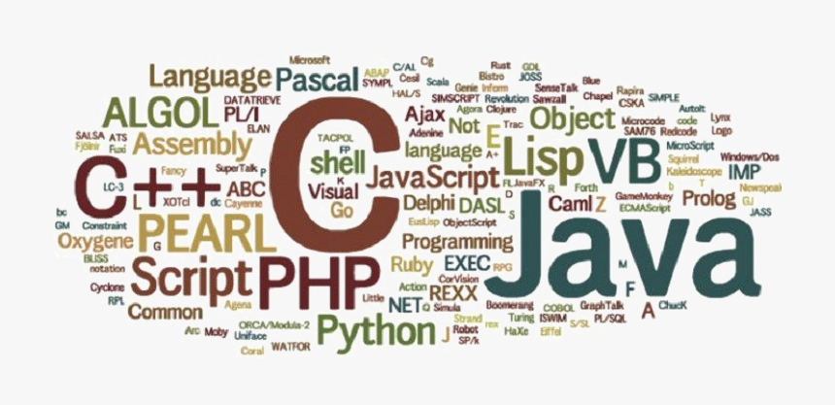
How to choose a programming language?
Different programming languages have different strengths and areas of application.
Some languages are optimized for web development, while others excel in scientific computing, data analysis, or artificial intelligence.
For example, Python is widely used for web development, scientific computing, and machine learning due to its simplicity, versatility, and extensive libraries.
420-SS9-UM - Fundamentals of Python Programming | Montreal College IT

Slide 28
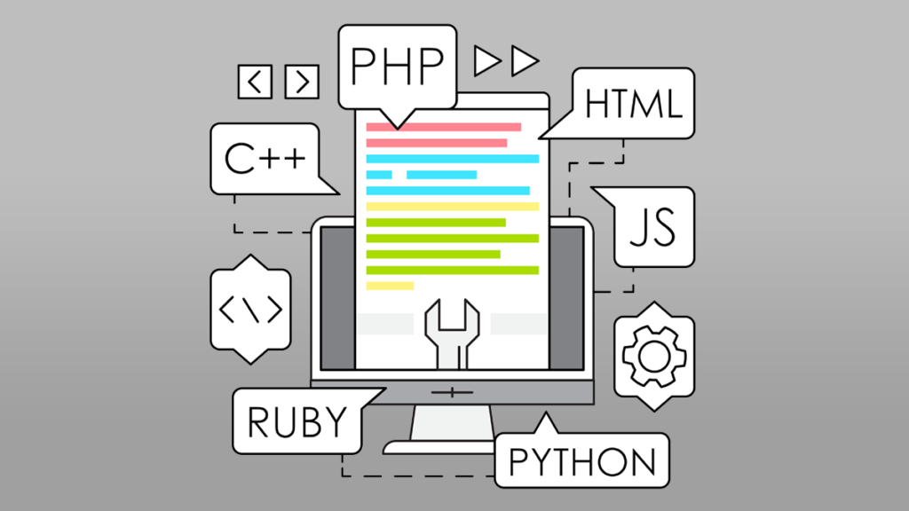
How to choose a programming language?
When choosing a programming language, it is crucial to consider factors such as:
the nature of the project
the target platform or environment
the availability of resources
community support
personal preferences or familiarity
Each language comes with its own trade-offs in terms of performance, development time, and scalability.
420-SS9-UM - Fundamentals of Python Programming | Montreal College IT

Slide 29
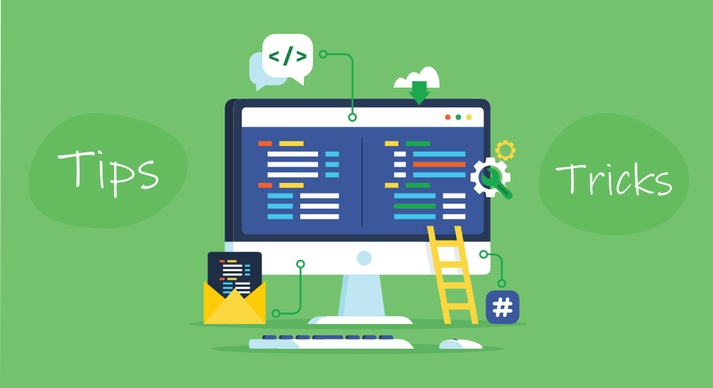
How to learn a programming language?
Learning a programming language involves understanding its syntax, semantics, and best practices.
It requires grasping fundamental programming concepts such as variables, data types, control structures, functions, and object-oriented programming principles.
While the learning curve for each language may vary, many beginners find high-level languages like Python to be more approachable and beginner-friendly due to their clear syntax and extensive documentation.
420-SS9-UM - Fundamentals of Python Programming | Montreal College IT

Slide 30
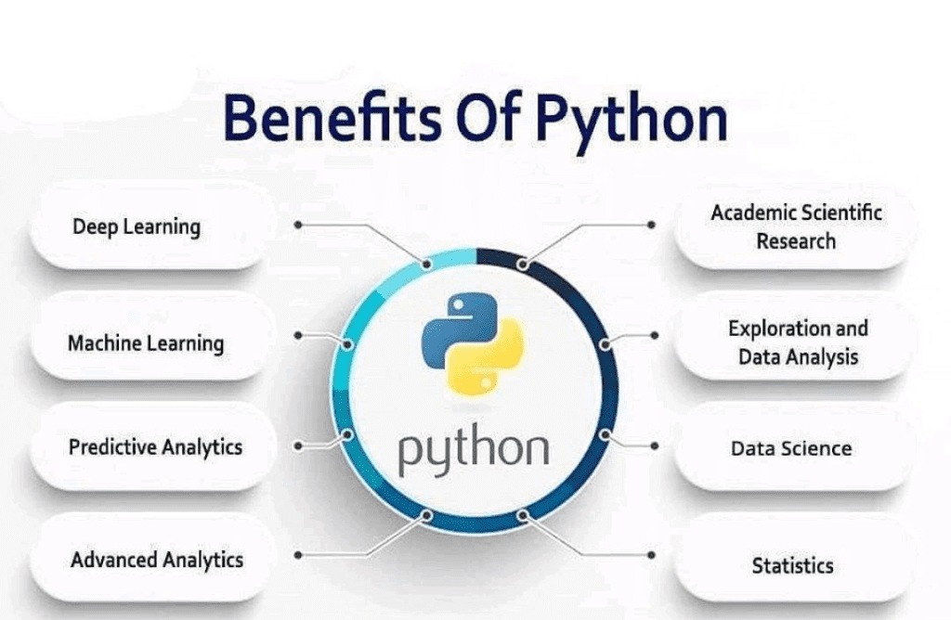
Why Choose Python
Python is a versatile and powerful programming language that has gained immense popularity among developers worldwide. It offers several compelling reasons why it is an excellent choice for both beginners and experienced programmers.
420-SS9-UM - Fundamentals of Python Programming | Montreal College IT

Slide 31
Python’s Simplicity and Versatility
Python is known for its simplicity, clean syntax, and readability. It has a small number of reserved keywords, making it easy to learn and understand while reducing syntax errors and promoting code maintainability.
Python is a versatile and easy-to-use language that offers a wide range of programming constructs, including complex dynamic data types, structured and functional programming paradigms, and comprehensive support for object-oriented programming. With its vast library of classes and functions, Python can handle diverse applications and domains.
420-SS9-UM - Fundamentals of Python Programming | Montreal College IT

Slide 32
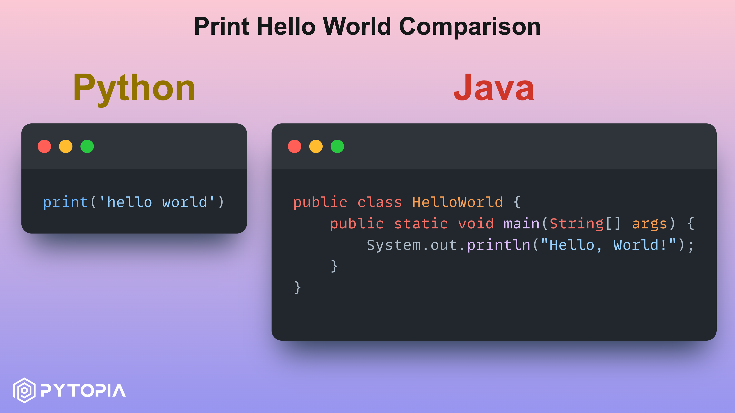
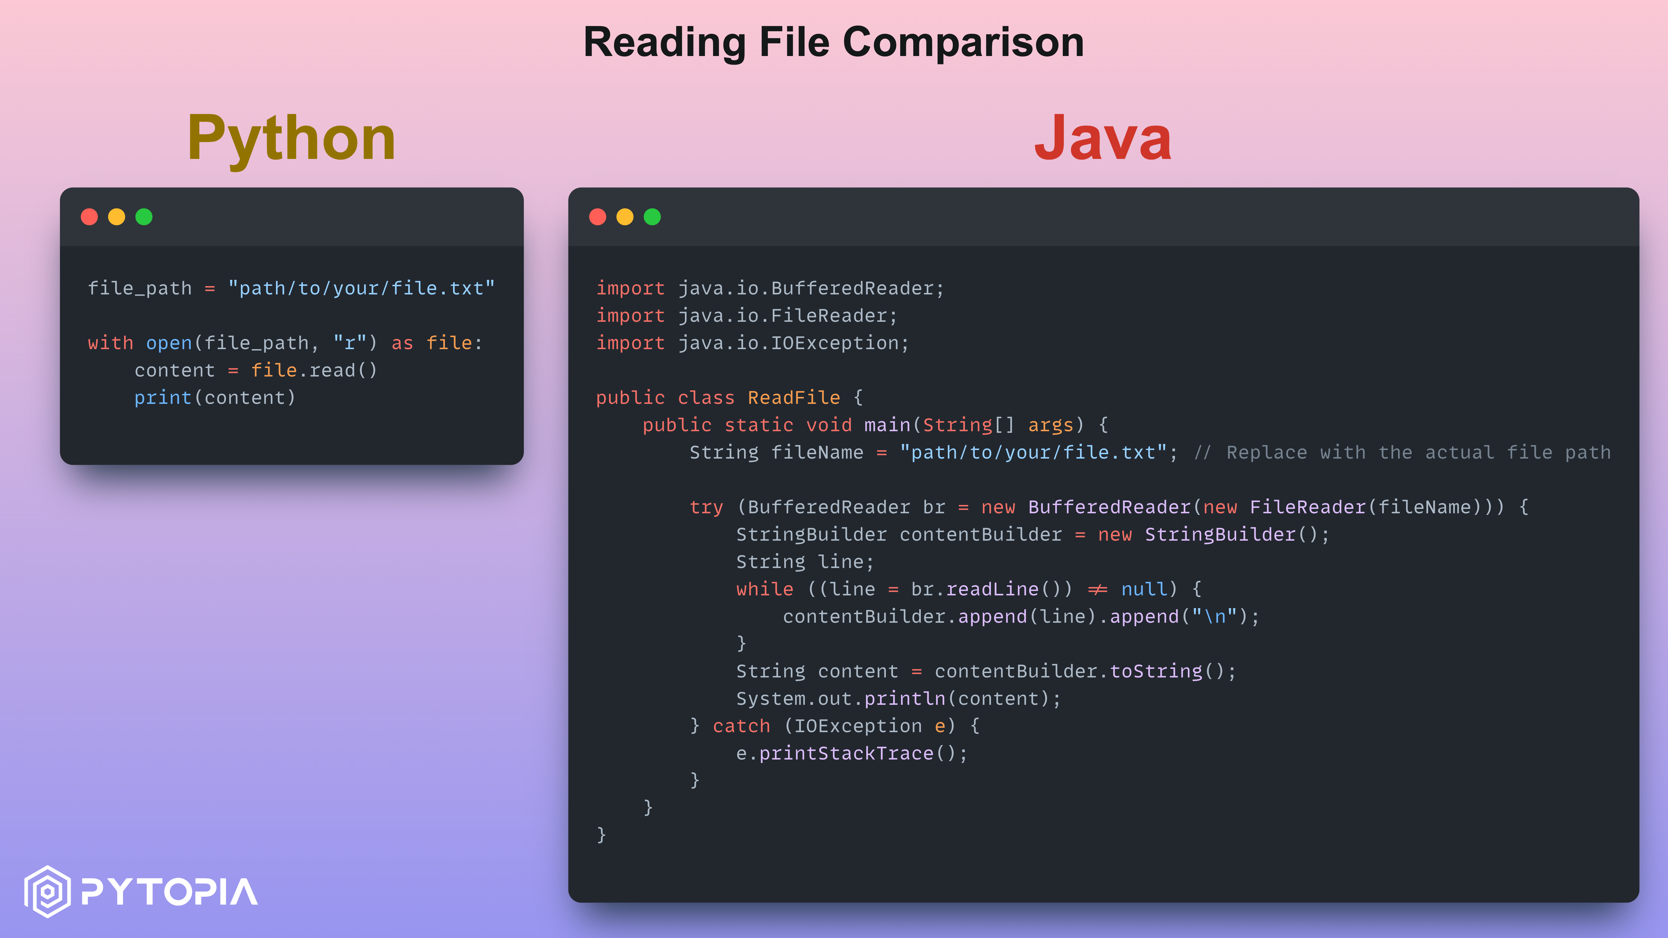
Python’s Simplicity and Versatility
420-SS9-UM - Fundamentals of Python Programming | Montreal College IT

Slide 33
Python’s Features and Applications
Python is widely recognized for its extensive array of features. When coupled with its simplicity and robust community support, Python becomes an exceptional option for a broad spectrum of applications.
Features such as:
Dynamic Typing and Automatic Memory Management
Extensive Standard Library and Third-Party Packages
Object-Oriented Programming (OOP)
Multiplatform Support
Web Development
Data Analysis and Scientific Computing
Machine Learning and Artificial Intelligence
420-SS9-UM - Fundamentals of Python Programming | Montreal College IT

Slide 34
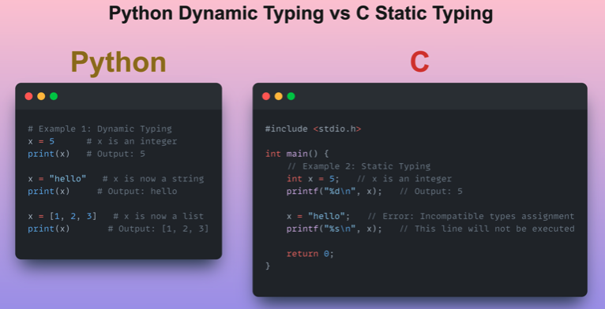
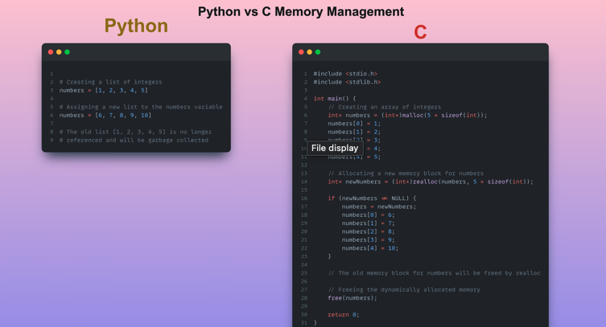
Python’s Features and Applications
420-SS9-UM - Fundamentals of Python Programming | Montreal College IT

Slide 35
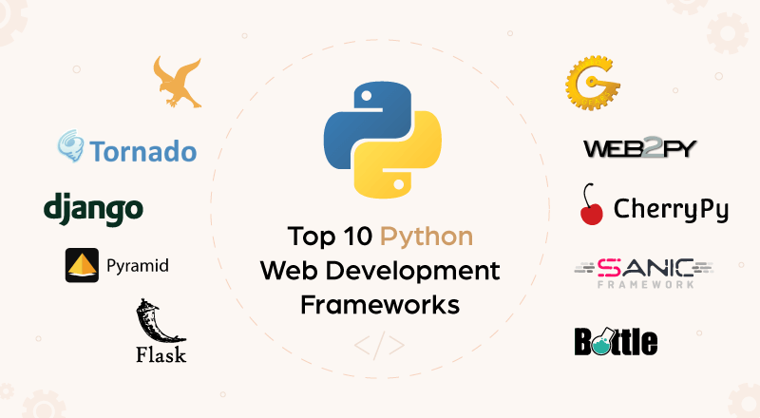
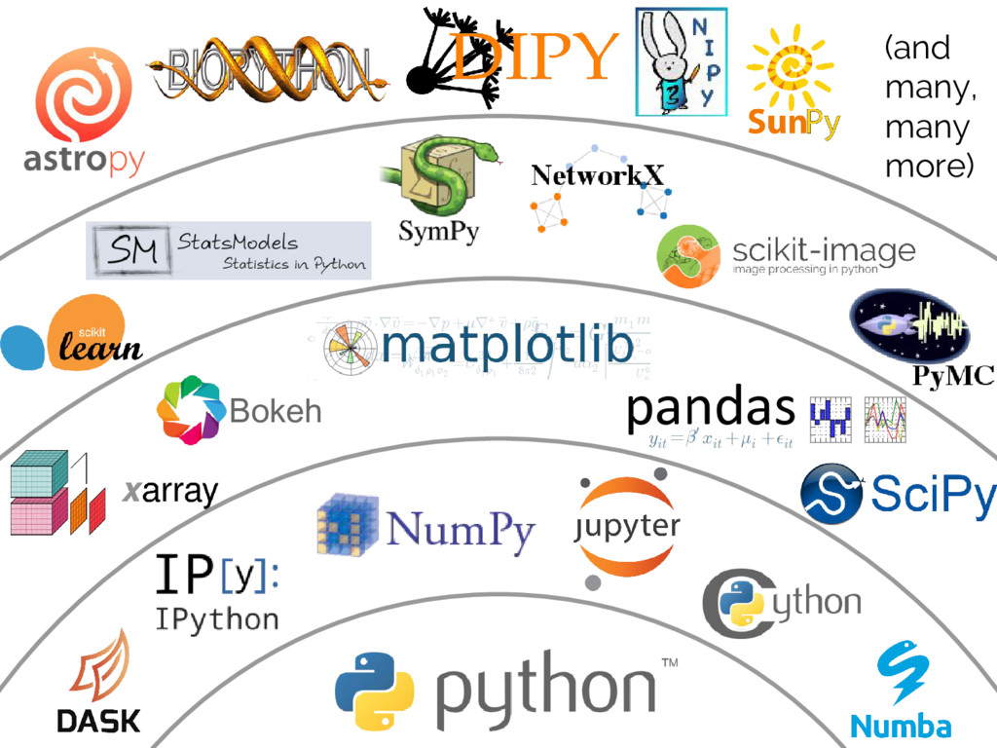
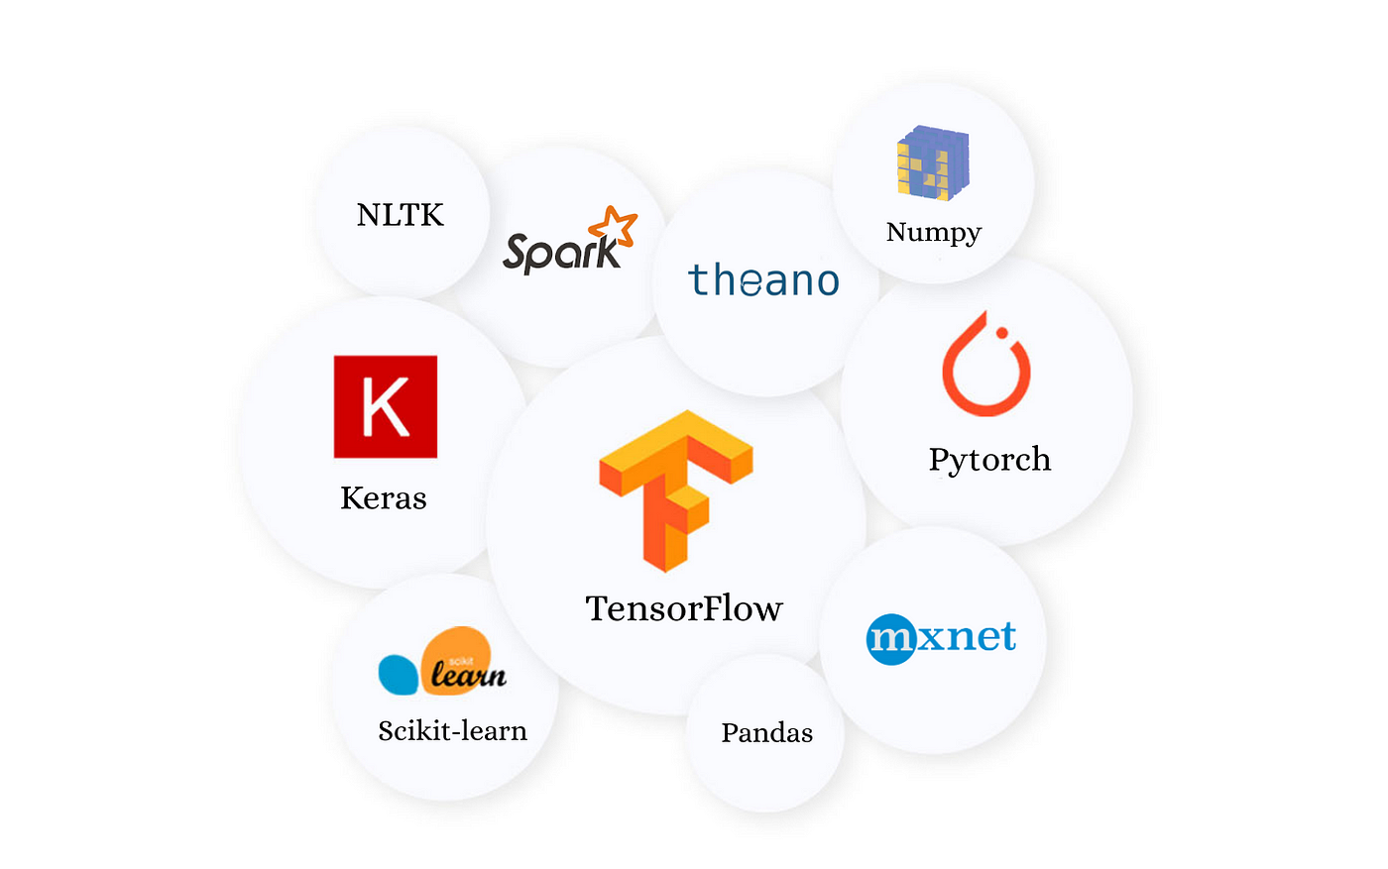
Python’s Features and Applications
420-SS9-UM - Fundamentals of Python Programming | Montreal College IT

Slide 36
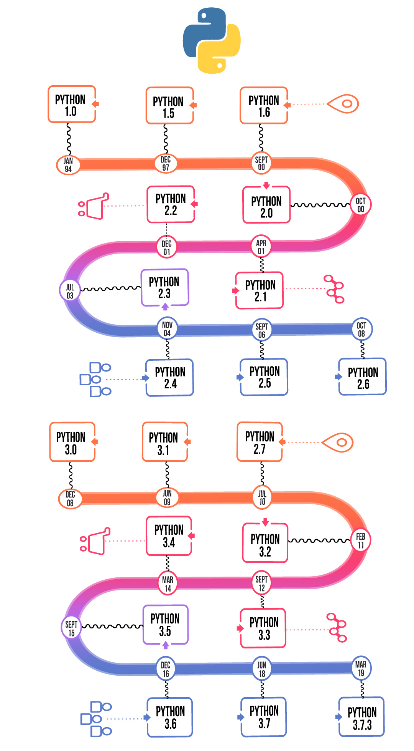
Python Versions
Python has undergone significant changes and improvements over the years, resulting in different language versions.
The two main versions that coexist are Python 2 and Python 3.
Python 2 was released in 2000, and it has become the standard version of Python for over a decade. However, Python 2 reached its end of life in January 2020 and is no longer actively maintained or updated by the Python core development team.
Python 3 was introduced in 2008 with the goal of addressing some of the design flaws and limitations of Python 2. As of February 2024, the latest stable version of Python is Python 3.11.
420-SS9-UM - Fundamentals of Python Programming | Montreal College IT

Slide 37
Python Versions
Key differences and benefits of Python 3:
Print Statement vs. Print Function: In Python 2, the print statement was used for outputting text, while Python 3 introduced the print function, making it consistent with other function calls in the language.
Unicode Support: Python 3 offers better support for Unicode, making it easier to handle and process text from different languages and character sets.
Improved Syntax: Python 3 introduced several syntax enhancements and language improvements.
Enhanced Libraries and Modules: As Python 3 gained traction, many libraries and modules started focusing on Python 3 compatibility.
Future Development and Community Support: Python 3 is actively developed and receives regular updates, bug fixes, and security patches.
420-SS9-UM - Fundamentals of Python Programming | Montreal College IT

Slide 38
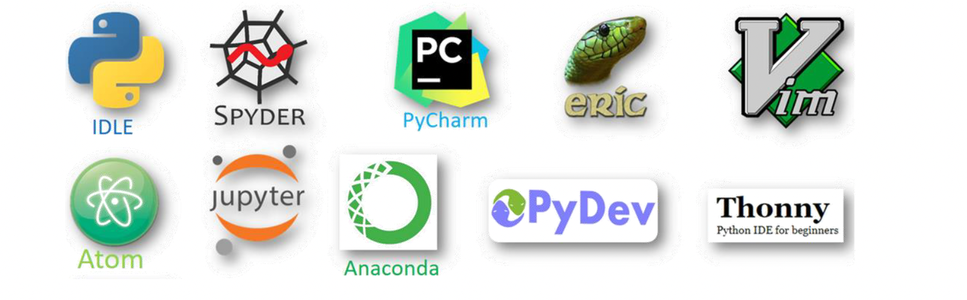
IDE vs. IDLE
An Integrated Development Environment (IDE) is a software environment that usually consists of a software development package containing a Code Editor, Build Automation, Tools, and a Debugger.
An Integrated Development and Learning Environment (IDLE) includes the basic packages and concepts of an IDE in addition to learning and educational purposes.
IDE VS IDLE
420-SS9-UM - Fundamentals of Python Programming | Montreal College IT

Slide 39
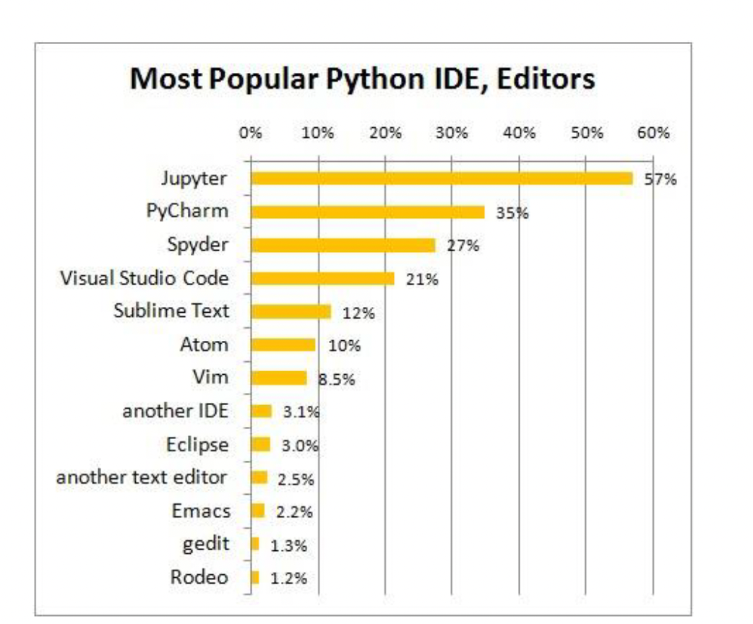
Jupyter
Like traditional IDEs, Jupyter allows for writing, running, and debugging code. Its interactive nature lets users execute code in blocks or cells, making it especially useful for experimental and iterative coding, data analysis, and visualization tasks.
420-SS9-UM - Fundamentals of Python Programming | Montreal College IT

Slide 40
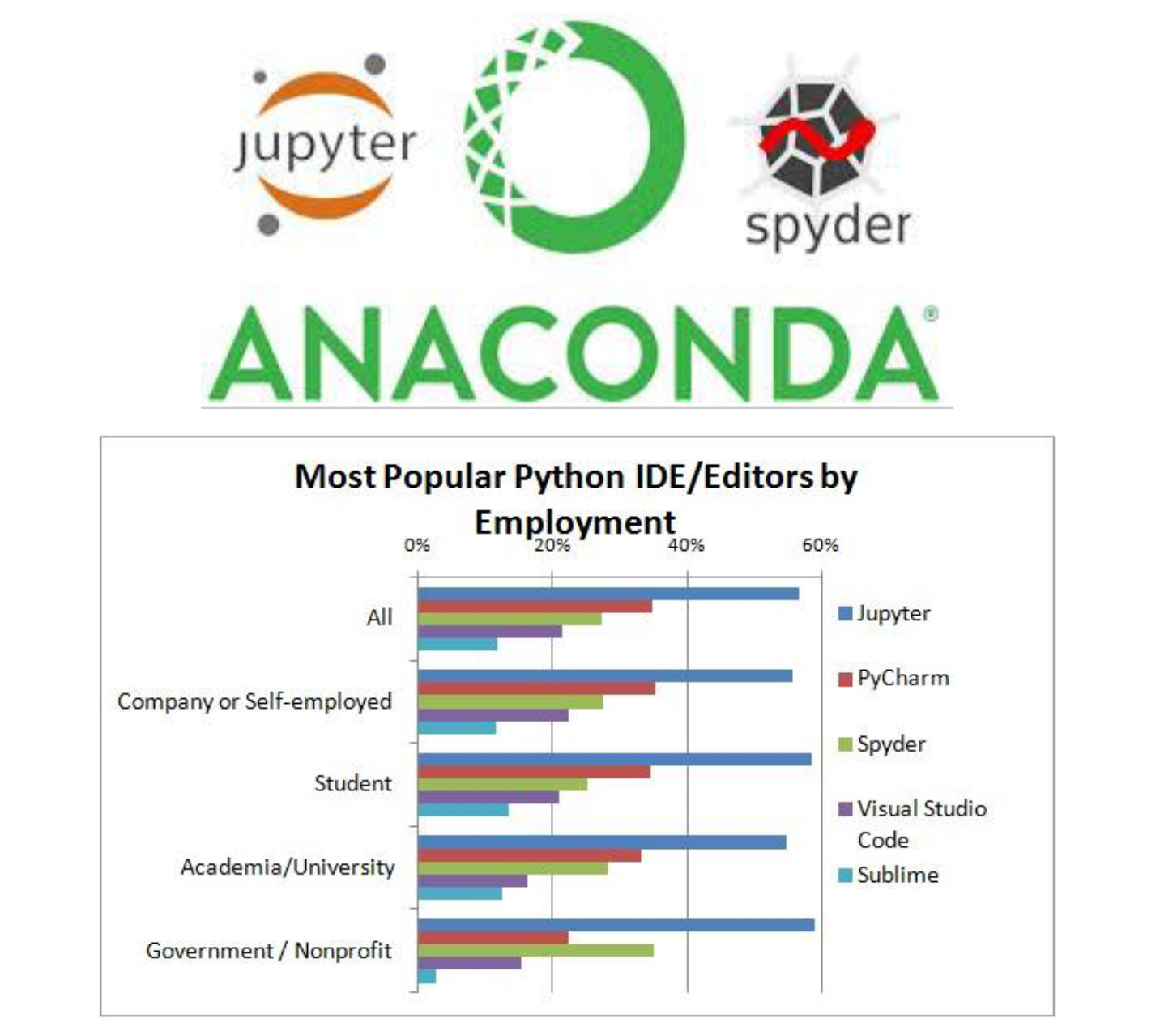
Anaconda
While Anaconda is not an IDE, it is a comprehensive suite that includes IDEs like Spyder and Jupyter Notebooks, making it a powerful platform for Python development in data science and related fields.
Its primary purpose is to facilitate an easy-to-use, versatile computing environment for data science applications, with the inclusion of IDE tools being just one aspect of its broader offering.
420-SS9-UM - Fundamentals of Python Programming | Montreal College IT

Slide 41
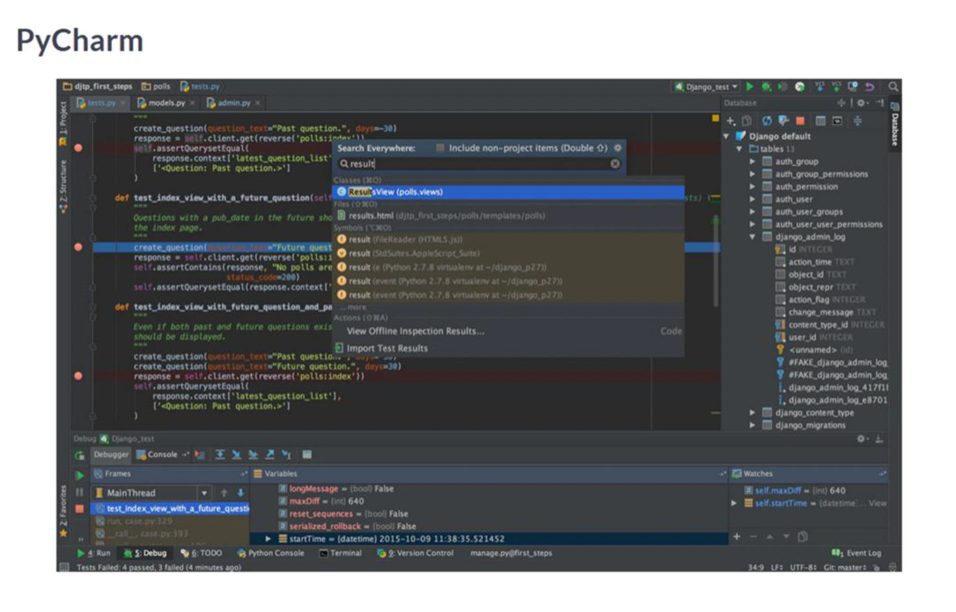
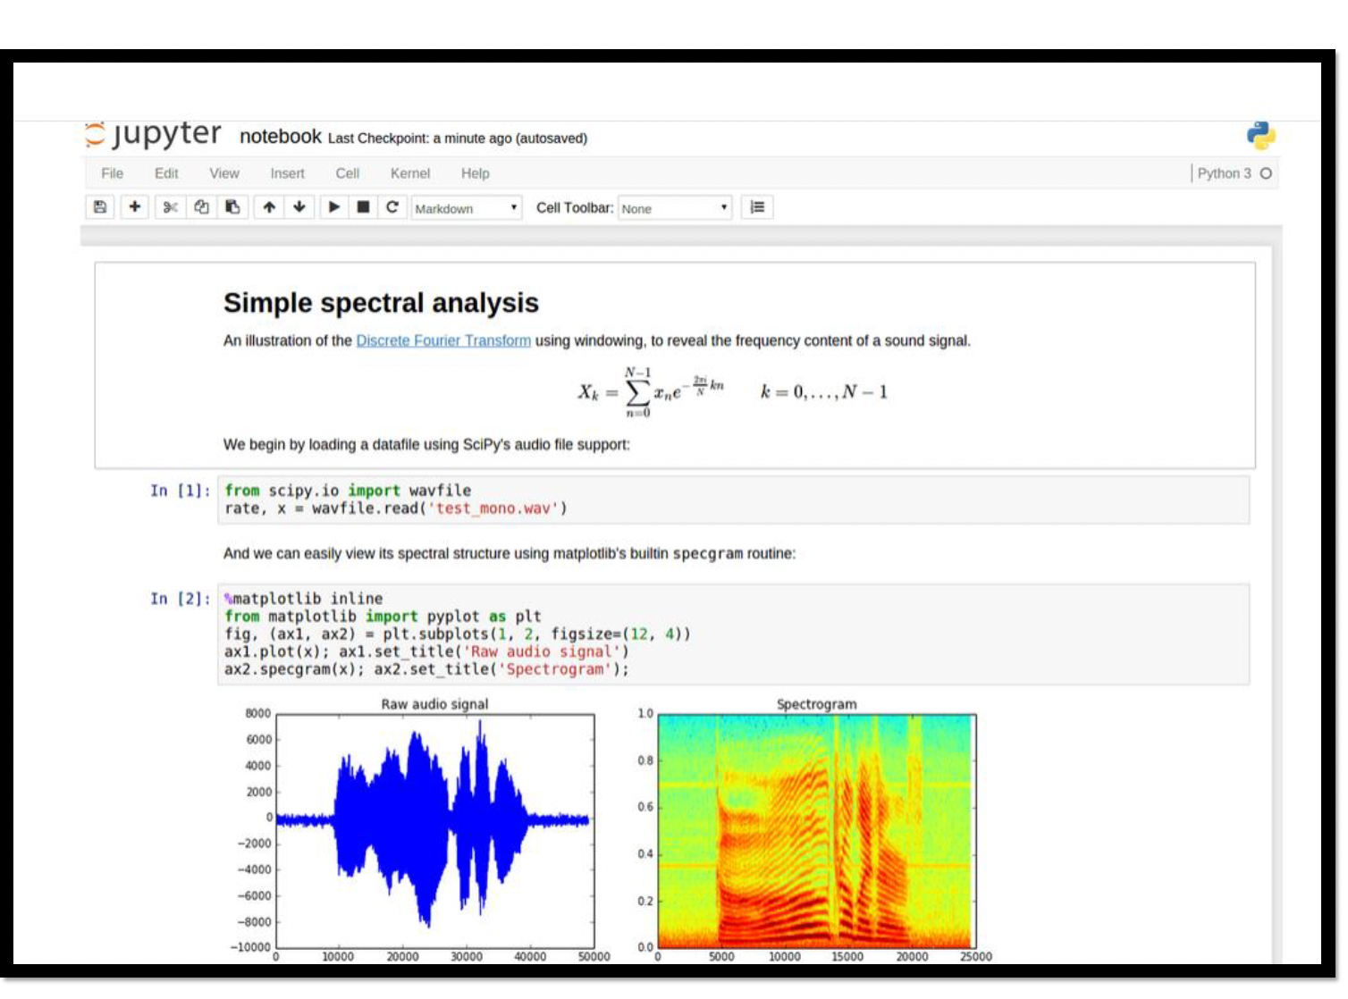
Examples: PyCharm vs. Jupyter
420-SS9-UM - Fundamentals of Python Programming | Montreal College IT

Slide 42
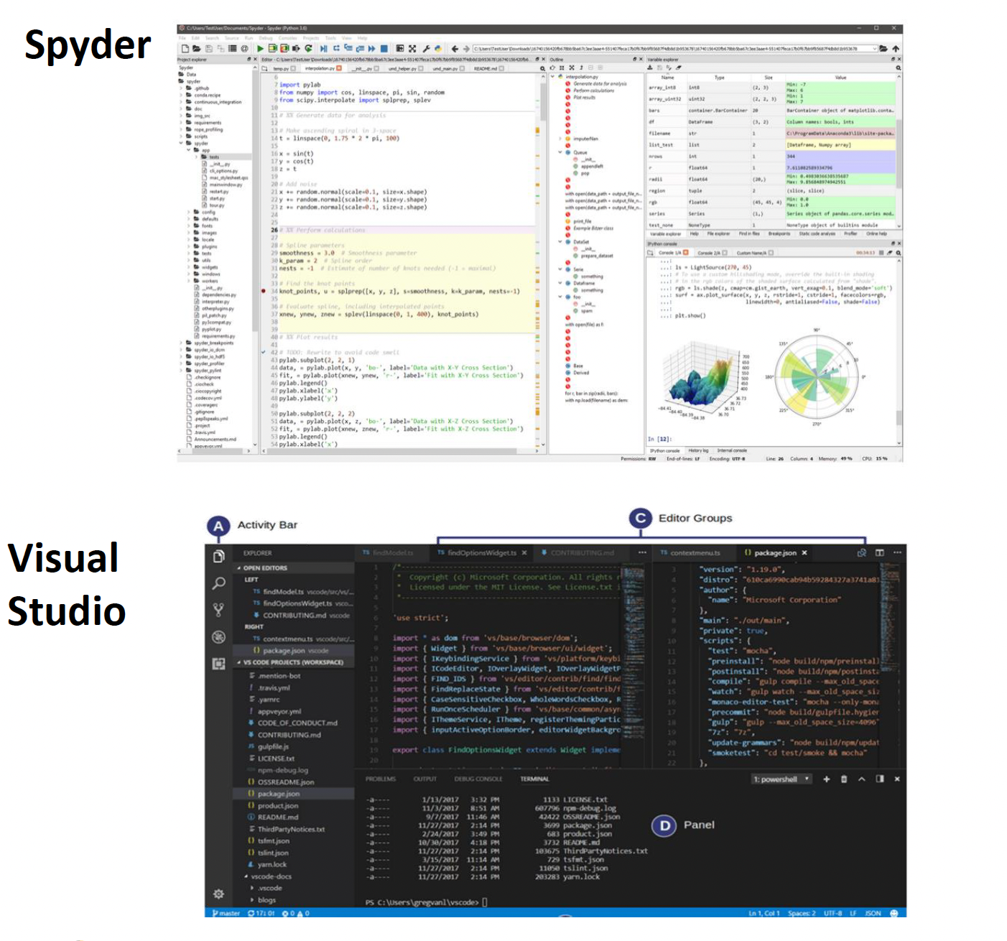
Example: Spyder vs. Visual Studio
420-SS9-UM - Fundamentals of Python Programming | Montreal College IT

Slide 43
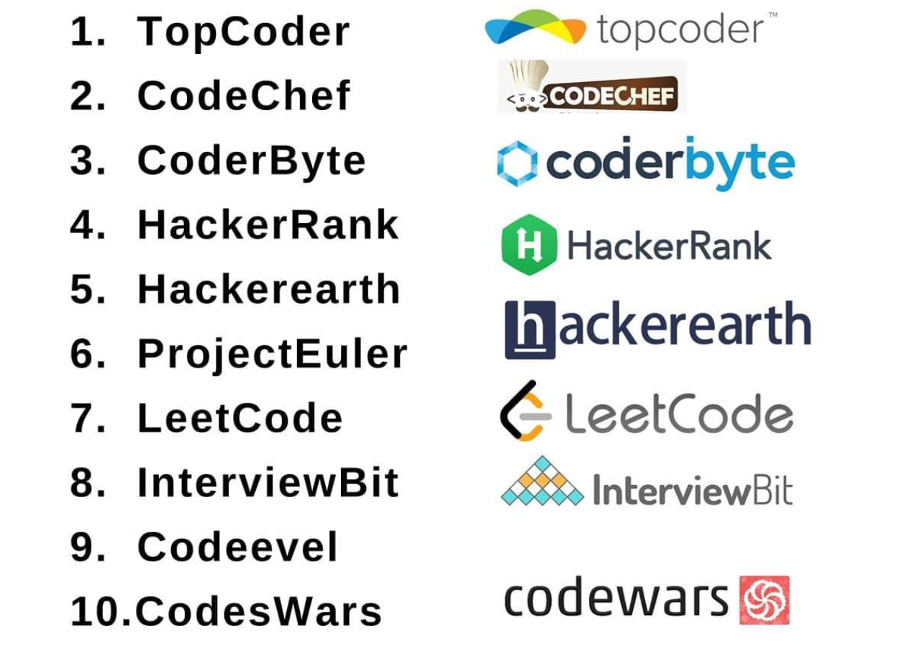
Websites for Practicing Coding
420-SS9-UM - Fundamentals of Python Programming | Montreal College IT

Slide 44
Environment Setup

Slide 45
Python Development Environment
Let’s start with discussing the benefits of using VS Code, Jupyter Notebook, and Conda together.
Understanding the tools and their advantages will set the foundation for a seamless Python development experience.
The Python Development Environment refers to the set of tools and software configurations required to write, run, debug, and manage Python code efficiently.
It contains text editors or integrated development environments (IDEs), package managers, and other supporting tools that enhance the development workflow.
420-SS9-UM - Fundamentals of Python Programming | Montreal College IT

Slide 46
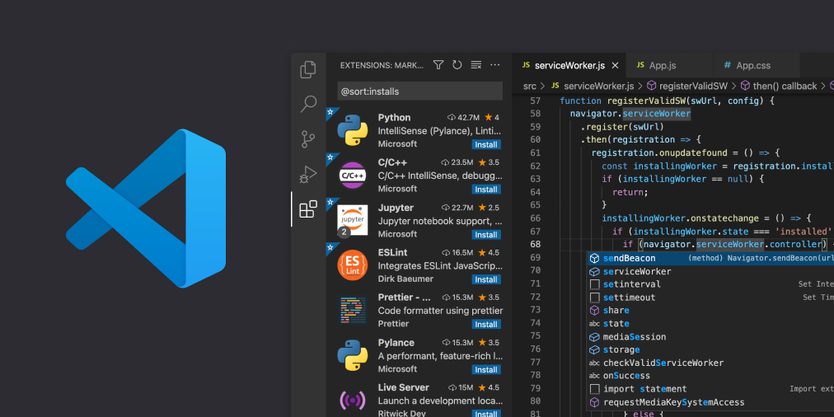
Visual Studio Code (VS Code)
VS Code is a lightweight and highly customizable code editor developed by Microsoft.
It offers robust features for Python development, including:
Syntax highlighting
Code completion
Debugging support
Version control integration
Extensibility through a wide range of extensions
420-SS9-UM - Fundamentals of Python Programming | Montreal College IT

Slide 47
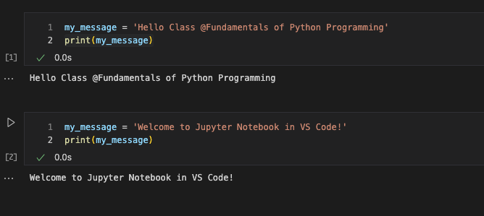
Jupyter Notebook
Jupyter Notebook is an interactive computing environment that allows users to create and share documents containing live code, visualizations, explanatory text, and more.
To enhance the functionality of VS Code for Jupyter Notebook development, we will be utilizing the Jupyter Notebook extension. This extension enables seamless integration between VS Code and Jupyter Notebook, allowing you to create, edit, and run Jupyter Notebooks directly within the editor.
It provides features such as cell execution, interactive outputs, and markdown rendering, making it a powerful tool for data analysis and prototyping.
420-SS9-UM - Fundamentals of Python Programming | Montreal College IT

Slide 48
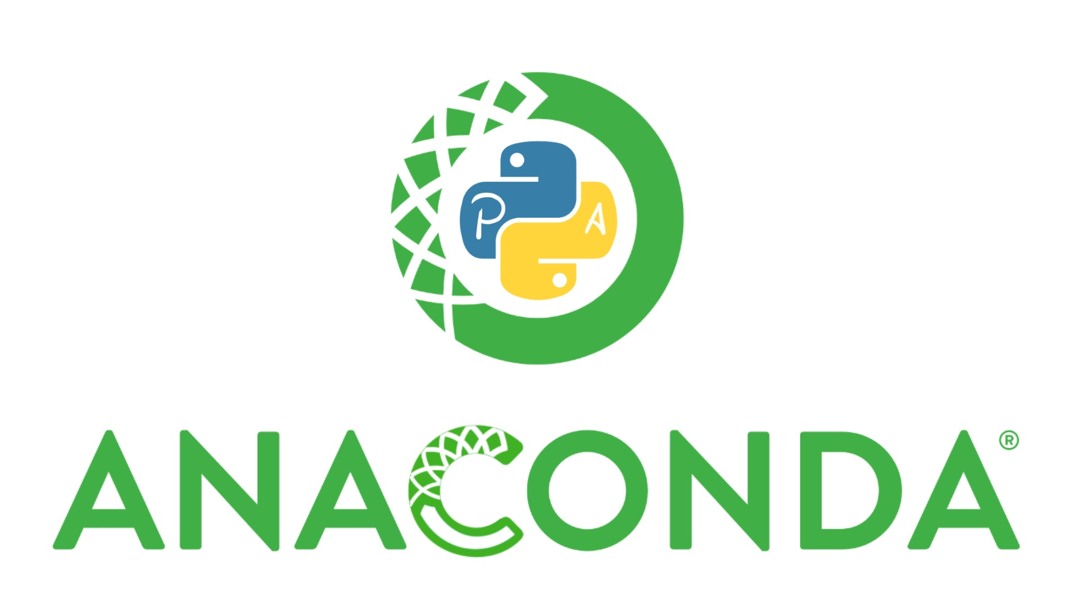
Conda
Conda is a popular package manager and environment management system for Python and other programming languages. It simplifies the process of installing, managing, and organizing packages and dependencies within isolated environments, ensuring reproducibility and avoiding conflicts between different projects.
Anaconda is a distribution of Python that aims to simplify package management and deployment.
Anaconda uses Conda as its package manager. When you install Anaconda, you also install Conda.
But what does this actually mean?
420-SS9-UM - Fundamentals of Python Programming | Montreal College IT

Slide 49

Understanding Conda and Anaconda through Cooking
Conda is like having an efficient kitchen organizer, essential for keeping your cooking space organized and functional, allowing for the preparation of any meal without ingredient (packages) or tool conflicts.
Anaconda is like stepping into a fully stocked kitchen, where you have everything you need to start cooking complex meals (data science projects) right away, without the need for setup.
420-SS9-UM - Fundamentals of Python Programming | Montreal College IT

Slide 50
Operating Systems and Terminal Setup
An operating system (OS) is the software that manages computer hardware and software resources and provides standard services for computer programs.
There are 3 major operating systems: macOS, Linux, and Windows.
To open the Terminal on macOS:
Press Command + Space to open Spotlight Search.
Type "Terminal" and press Enter.
To open the PowerShell in Windows:
1. Search for PowerShell
A terminal is a text-based interface for interacting with a computer's operating system through a command-line interface (CLI).
420-SS9-UM - Fundamentals of Python Programming | Montreal College IT

Slide 51
Command-Line Crash Course
The terminal is a powerful tool that allows you to interact with your computer using text-based commands.
As a Python developer, understanding and using the terminal is essential for tasks such as running scripts, managing files, and executing various development tools.
420-SS9-UM - Fundamentals of Python Programming | Montreal College IT

Slide 52
Navigating File System
Let’s try with basic terminal commands:
pwd >>> (print working directory) shows the current directory's path.
ls >>> (list) displays the files and directories in the current directory.
cd >>> (change directory) allows you to move between directories.
Example: cd documents
cd C:\Users\DATASCI
To open VS Code: code .
code
420-SS9-UM - Fundamentals of Python Programming | Montreal College IT

Slide 53
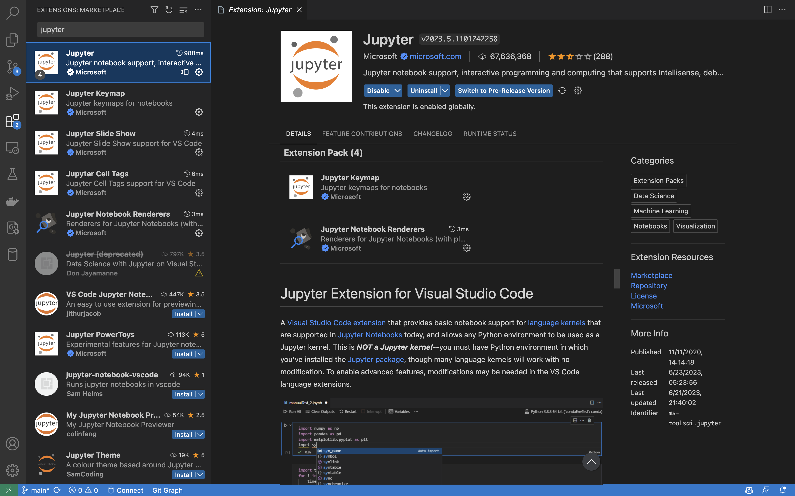
Installing the Python and Jupyter Extensions
The Jupyter extension for VS Code allows you to work with Jupyter Notebooks directly within the editor. Jupyter Notebooks provides an interactive data analysis, visualization, and code experimentation environment.
To install the Jupyter extension, follow these steps:
Open VS Code.
Click on the "Extensions" button in the left sidebar (or press Ctrl+Shift+X).
In the search bar, type "Jupyter" and hit Enter.
Click the "Install" button next to the "Jupyter" extension to install it.
Do the same for Python extension.
Try ctrl + shift + P
420-SS9-UM - Fundamentals of Python Programming | Montreal College IT

Slide 54
Vs Code Interface Tour
Let's begin our journey by getting familiar with the VS Code interface.
Upon launching VS Code, you'll notice the main components:
Editor: The central area where you write and edit your code. It offers a plethora of functionalities to ease your coding experience.
Sidebar: On the left-hand side, you'll find the sidebar with various panels, such as Explorer for file navigation, Source Control for version control, and Extensions for managing your installed extensions.
Status Bar: Situated at the bottom, the status bar displays essential information like the file type, line and column numbers, and indentation settings.
Command Palette: Accessible through Ctrl+Shift+P >>> The Command Palette allows you to execute commands and access various features with ease.
420-SS9-UM - Fundamentals of Python Programming | Montreal College IT

Slide 55
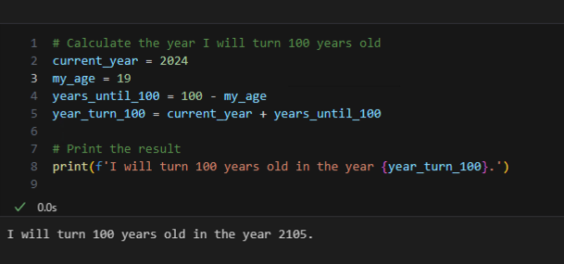
Run the First Program
Write a program that determines the year when someone will turn 100 years old based on their current age.
How to add line numbers?
420-SS9-UM - Fundamentals of Python Programming | Montreal College IT

Slide 56
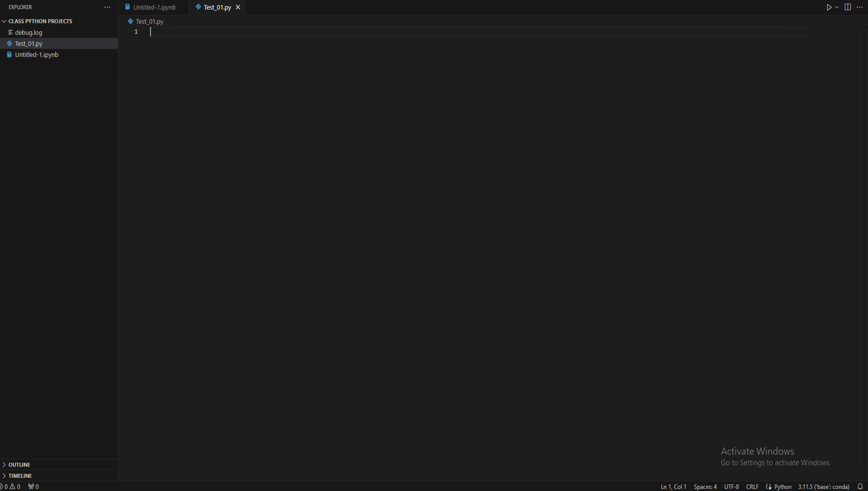
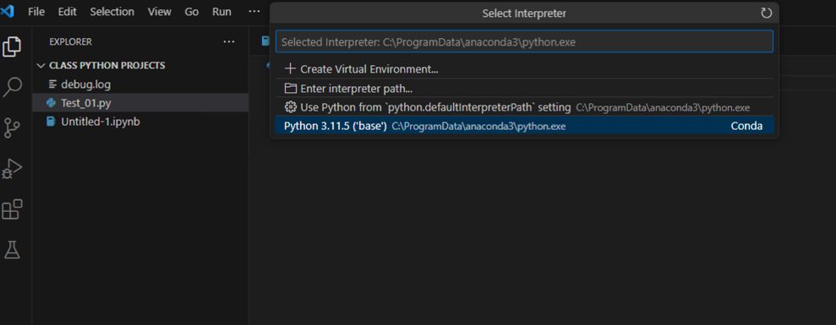

Create a Python Project Folder
Open (Create) your Python project folder in VS Code.
At the bottom right corner of the window, click on the Python interpreter version. It may display the default interpreter or another interpreter you previously selected.
In the list that appears, select an interpreter from the list (anaconda)
Select the desired interpreter from the list, whether it's a global interpreter that came with your operating system or a Conda interpreter you created for this project.
420-SS9-UM - Fundamentals of Python Programming | Montreal College IT

Slide 57
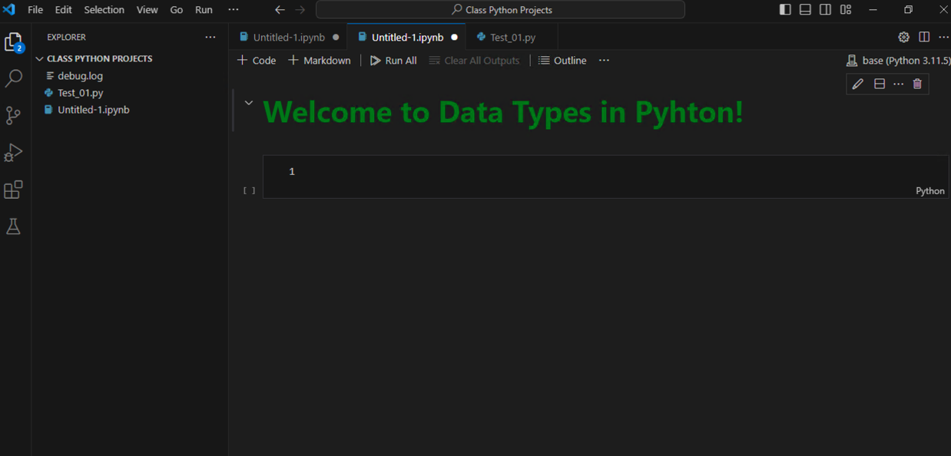
Congratulations on Setting Up the Environment
Congratulations! You have successfully set up Python and VS Code with Jupyter Notebook and Conda as the package managers.
By completing these steps, you now have a powerful development environment that allows you to write, execute, and document your Python code efficiently. You are ready to dive into the exciting world of Python programming!
420-SS9-UM - Fundamentals of Python Programming | Montreal College IT

Slide 58
Object Types

Slide 59

Basic Data Types
Data types are a fundamental concept in computer programming, representing different kinds of data that can be processed.
Just as in the real world, where we differentiate between types of data – for example, the difference between names, ages, and salaries – in computer programming, we categorize data into specific types for processing.
420-SS9-UM - Fundamentals of Python Programming | Montreal College IT

Slide 60
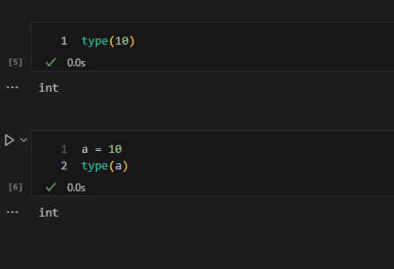
Type Function
The type function is a built-in Python function that returns the type of an object.
This function can be handy to determine the data type of a variable or value, especially when you are working with data from unknown sources or when debugging.
420-SS9-UM - Fundamentals of Python Programming | Montreal College IT

Slide 61
Data Types
Basic Data Types
Variables and Naming Variables
Conversion between Data Types
420-SS9-UM - Fundamentals of Python Programming | Montreal College IT

Slide 62
Exercise
Assign values to three variables myAge, my_name, and MyHeight in a single line.
Print the values.
Create a constant named MAX_SCORE and set its value to 100.
Multiplied myAge and MyHeight by MAX_SCORE.
420-SS9-UM - Fundamentals of Python Programming | Montreal College IT

Slide 63
Operators and Expressions
In the programming world, operators and expressions are fundamental building blocks that allow us to perform operations on data and evaluate results.
Operators are special symbols in Python that carry out arithmetic, logical, or relational computations. They act as a bridge, connecting values and variables to produce a desired result.
Expressions, on the other hand, are combinations of values, variables, and operators that, when evaluated, produce a result. Think of them as mathematical equations that the computer solves to give us an answer.
420-SS9-UM - Fundamentals of Python Programming | Montreal College IT

Slide 64
Assignment 1
**Exercise 1:** Write a Python program to calculate the area and perimeter of a rectangle with width 7 and height 5. Use arithmetic operators to calculate both values. **Exercise 2:** Given three grades, 88, 76, and 91, write a Python script to calculate the average grade. Use variables to store the grades and the arithmetic operators to calculate the average. **Exercise 3:** Assume you have $1000 USD and you want to convert it to Euros. The conversion rate is 1 USD to 0.85 Euros. Write a Python program to calculate how many Euros you will get after conversion. **Exercise 4:** The formula for a straight line is y = mx + b. If m = 5, b = 2, and y = 32, write a Python program to solve for x. **Exercise 5:** Write a Python script that checks if today's temperature is higher than yesterday's. Yesterday's temperature was 23 degrees Celsius, and today's is 25 degrees Celsius. Use comparison operators to find out the result. **Exercise 6:** Given a passing score of 50, write a Python program using comparison operators to check if a student's score of 47 qualifies as a pass or fail. **Exercise 7:** Write a Python script that determines if a given number $n$ is odd or even. Use the modulus operator for your check and print out "Odd" or "Even". **Exercise 8:** Write a Python program where you compare the ages of two people, Alice and Bob, who are 24 and 30 years old, respectively. Check if Alice is older than Bob, and print a message stating whether it's true or false.
420-SS9-UM - Fundamentals of Python Programming | Montreal College IT

